Slide 1
Cluster Analysis ——Model-Based Clustering Methods——
徐华
清华大学 计算机系 智能技术与系统国家重点实验室
xuhua@tsinghua.edu.cn

Slide 2
Cluster Analysis
What is Cluster Analysis?
Types of Data in Cluster Analysis
A Categorization of Major Clustering Methods
Partitioning Methods
Hierarchical Methods
Density-Based Methods
Grid-Based Methods
Model-Based Clustering Methods
Outlier Analysis
Summary

Slide 3
Model-Based Clustering Methods
Attempt to optimize the fit between the data and some mathematical model
Statistical and AI approach
Conceptual clustering
A form of clustering in machine learning
Produces a classification scheme for a set of unlabeled objects
Finds characteristic description for each concept (class)
COBWEB (Fisher’87)
A popular simple method of incremental conceptual learning
Creates a hierarchical clustering in the form of a classification tree
Each node refers to a concept and contains a probabilistic description of that concept

Slide 4
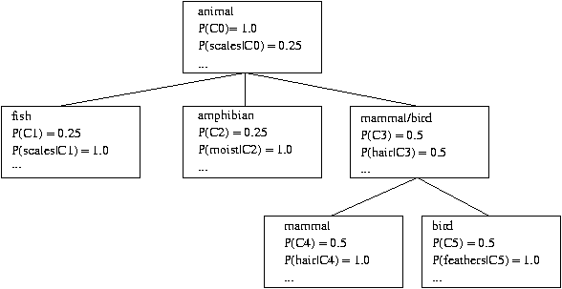
COBWEB Clustering Method
A classification tree

Slide 5
More on Statistical-Based Clustering
Limitations of COBWEB
The assumption that the attributes are independent of each other is often too strong because correlation may exist
Not suitable for clustering large database data – skewed tree and expensive probability distributions
CLASSIT
an extension of COBWEB for incremental clustering of continuous data
suffers similar problems as COBWEB
AutoClass (Cheeseman and Stutz, 1996)
Uses Bayesian statistical analysis to estimate the number of clusters
Popular in industry

Slide 6
Thanks！
Notes:
工作新意图发现

